Slide 1

Visit With Us – Project 5
Sarah A. Thomas

Slide 2
Business Problem Overview and Solution Approach
Currently, there are 5 travel packages offered through Visit With Us: Basic, Standard, Deluxe, Super Deluxe, and King. Last year, 18% of potential customers purchased a package.
A new package is being planned called the Wellness Tourism Package that allows the traveler to maintain, enhance, or kick-start a healthy lifestyle. Is this a viable package? What should the marketing strategy be?
The goal of the Data Science team is to generate a statistical model using Python to figure out which data points can help predict who of the potential customer base is likely to purchase a package. The team will use a variety of Bagging and Boosting techniques to construct the models.

Slide 3
Data Overview (1 of 2)
Variable | Description
CustomerID | Unique Customer ID
ProdTaken | Whether the customer has purchased a package (0:No, 1:Yes)
Age | Age of customer
TypeofContact | How customer was contacted (Company Invited or Self Enquiry)
CityTier | Depends on the development of a city, population, facilities, and living standards (Tier 1 > Tier 2 > Tier 3)
Occupation | Occupation of customer
Gender | Gender of customer
NumberOfPersonVisiting | Total number of persons planning to take trip with the customer
PreferredPropertyStar | Preferred hotel property rating by customer
MaritalStatus | Marital status of customer

Slide 4
Data Overview (2 of 2)
Variable | Description
NumberOfTrips | Average number of trips in a year by customer
Passport | Whether the customer has a passport (0:No, 1:Yes)
OwnCar | Whether the customer owns a car (0:No, 1:Yes)
NumberOfChildrenVisiting | Number of children <5 yrs planning to take trip with customer
Designation | Designation of the customer in the current organization
MonthlyIncome | Gross monthly income of the customer
PitchSatisfactionScore | Sales pitch satisfaction score
ProductPitched | Product pitched by the salesperson
NumberOfFollowups | Total number of follow-ups done by the salesperson after the pitch
DurationOfPitch | Duration of sales pitch

Slide 5
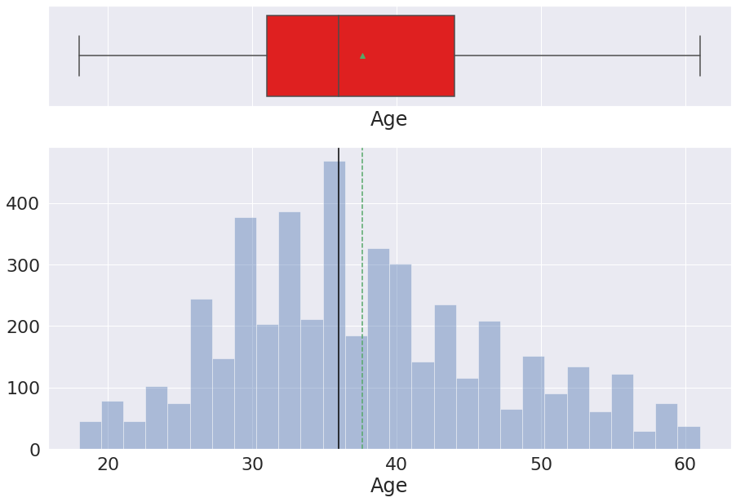
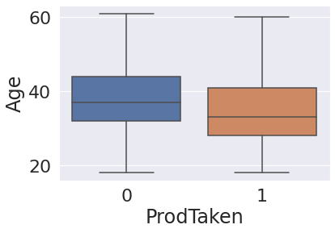
Age
Age ranges from 18 to 61 with a median age of 36 and mean of 37.62. Indicates right-skewed distribution. Customers who purchase travel package tend to be slightly younger.

Slide 6
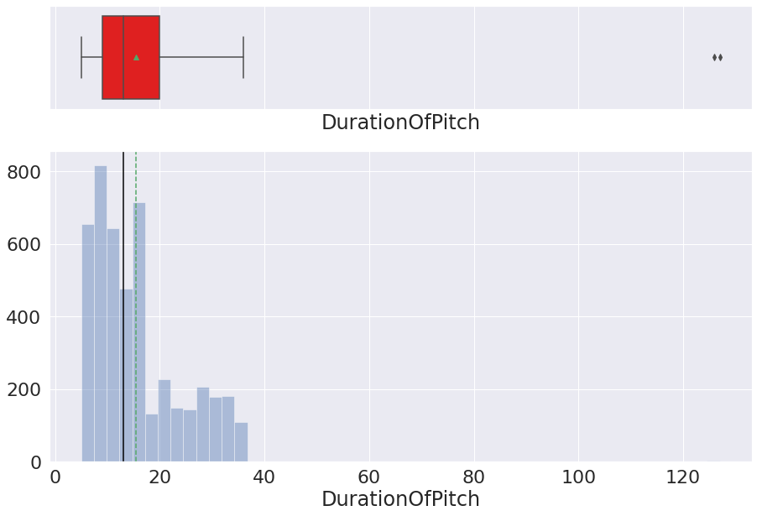
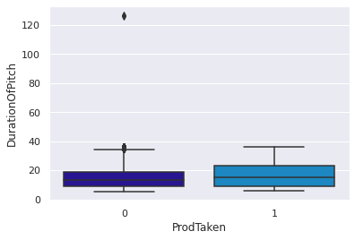
Duration of Pitch
The mean is 15.49 minutes and the median is 13. Indicates a right-skewed distribution. Much longer pitches did not result in packages being purchased.

Slide 7
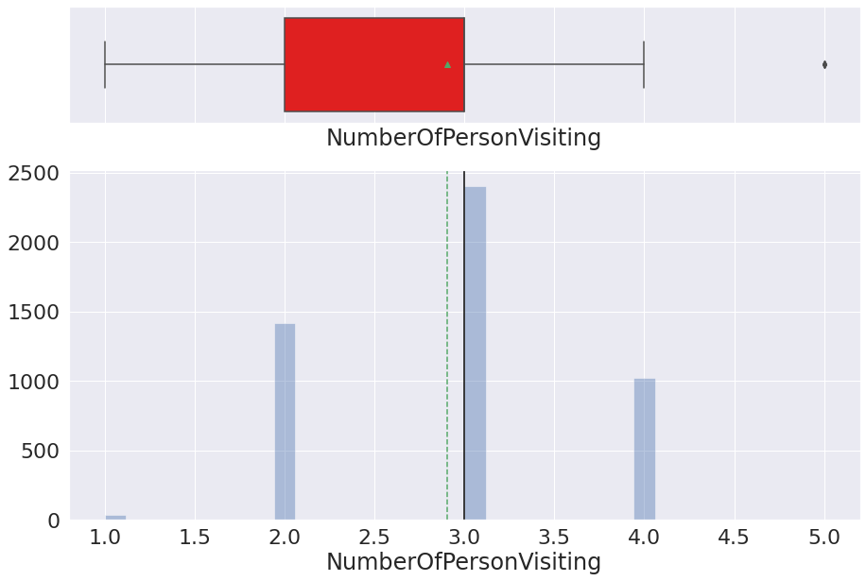
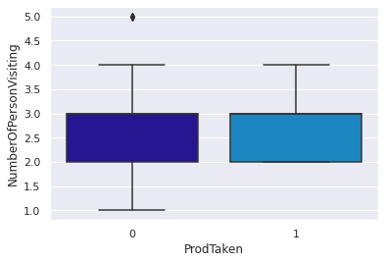
Number of Persons Visiting
The mean for number of persons planning to take a trip with the customer is 2.91 with a median of 3. Indicates a nearly symmetrical distribution. The number of persons going on the trip does not seem to make a difference in packages purchased.

Slide 8
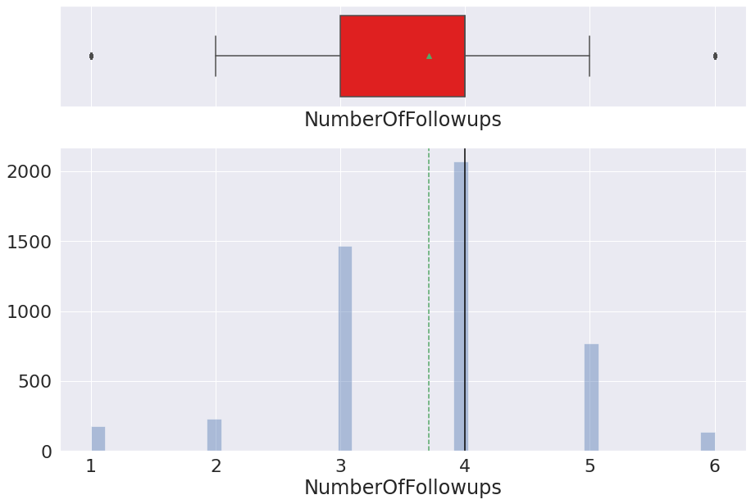
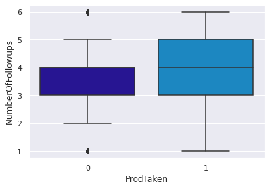
Number of Follow-ups
The mean number of follow-ups after the sales pitch is 3.71 and the median is 4.0, indicating a nearly symmetrical distribution. The number of followups appear to make a positive difference in the number of packages sold.

Slide 9
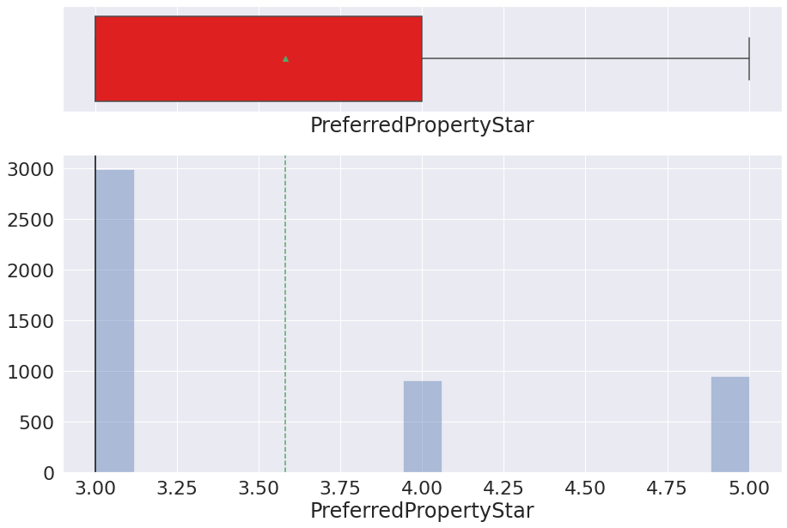
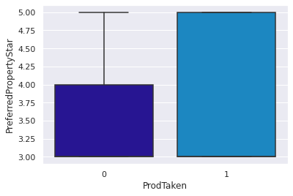
Preferred Property Star
The mean customer rating was 3.58 and the median was 3.0, indicating a slightly right-skewed distribution. Those who purchased packages tended to rate properties across a wider range (from lower to higher) in terms of property stars.

Slide 10
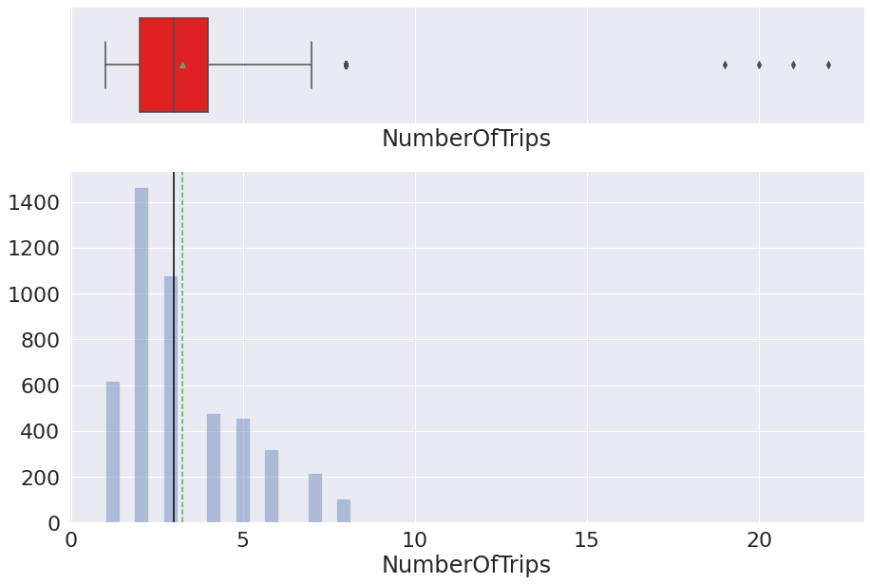
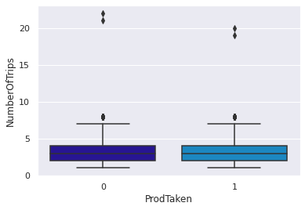
Number of Trips
The mean is 3.24 and the median is 3 indicating a nearly symmetrical distribution. NumberOfTrips does not seem to have a significant impact on whether packages are purchased.

Slide 11
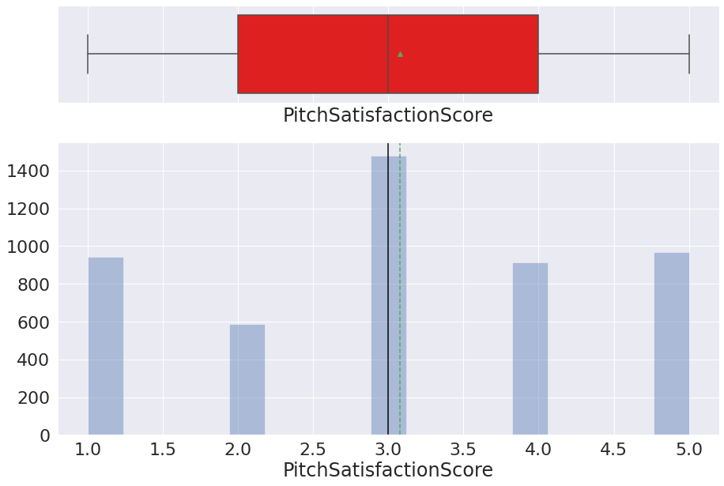
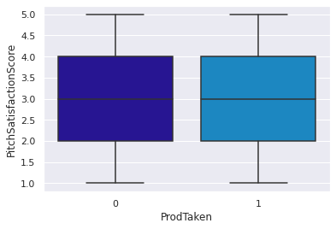
Pitch Satisfaction Score
The mean is 3.08 and the median is 3.0, indicating a nearly symmetrical distribution. PitchSatisfactionScore doesn't appear to have a great impact on whether or not a package is purchased.

Slide 12
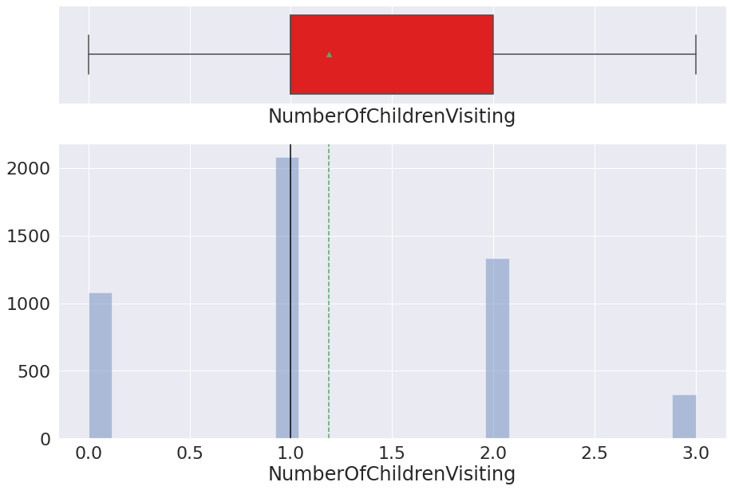
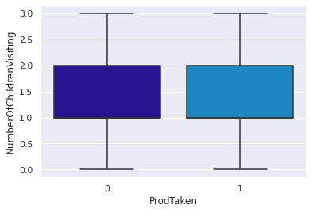
Number of Children Visiting
Number of children less than age 5 planning to take the trip with the customer - mean is 1.19 and median is 1.0 indicating a nearly symmetrical distribution. NumberOfChildrenVisiting does not appear to have an impact on whether or not a customer will purchase a package.

Slide 13
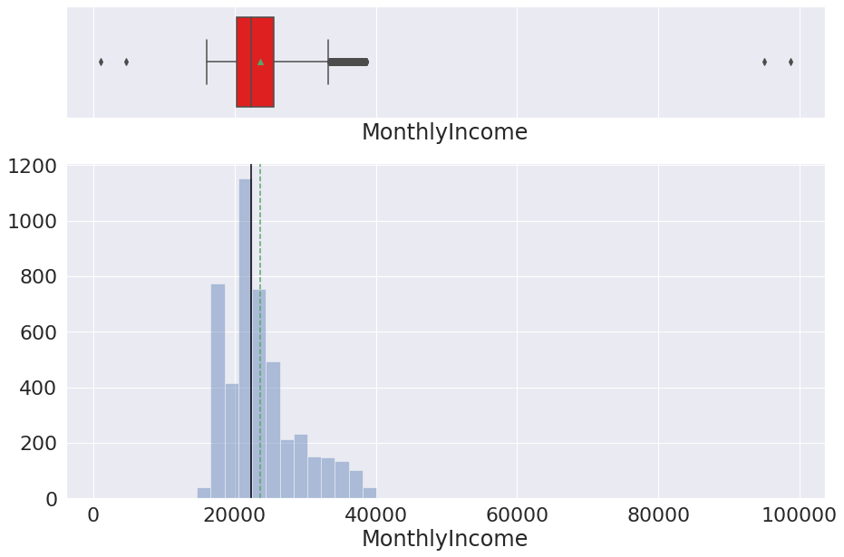
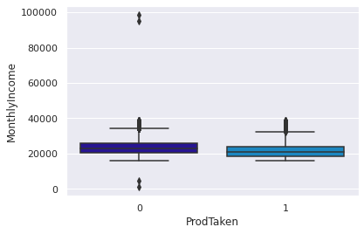
Monthly Income
Mean is 23619.85 and median is 22347 indicating a right-skewed distribution. A much higher income (looking in paricular at the outliers) does not dictate whether a package will be purchased.

Slide 14
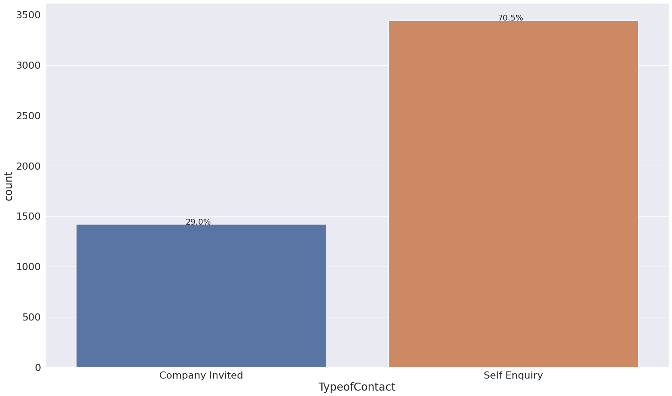
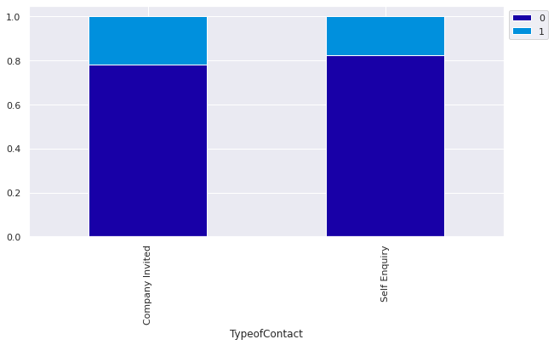
Type of Contact
Most customers were self enquiries. There does not seem to be a major difference in the number of packages sold depending on the type of contact (company invited or self inquiry).

Slide 15
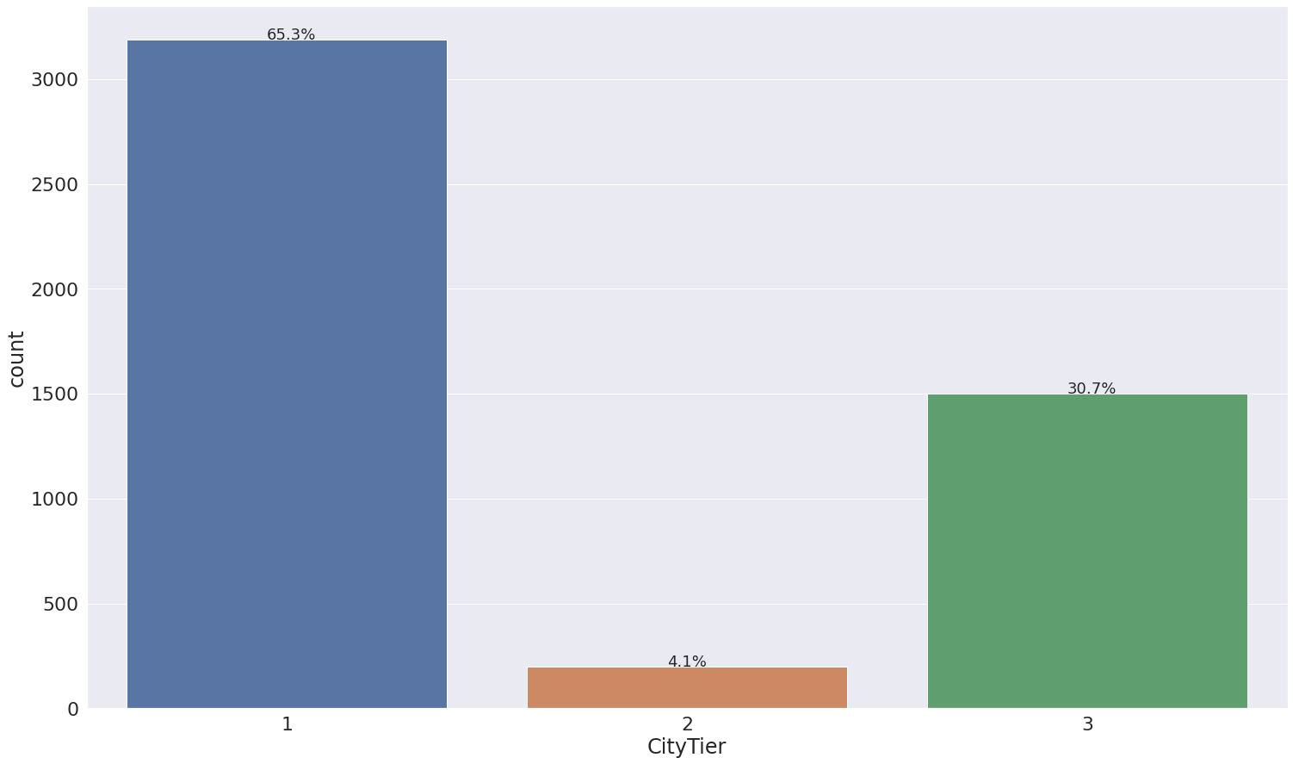
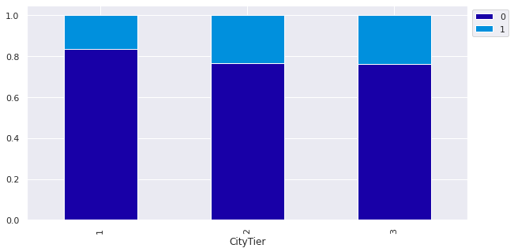
City Tier
Most are Tier 1. Although more packages were sold in CityTier 1, CityTiers 2 and 3 managed to have a higher percentage in each of their tiers of packages sold.

Slide 16
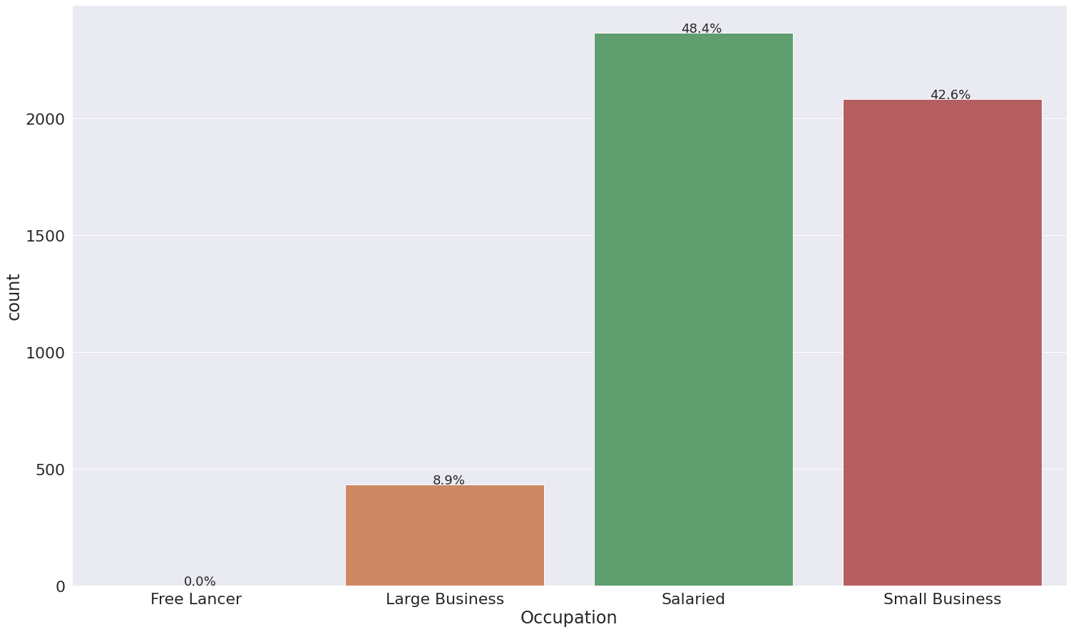
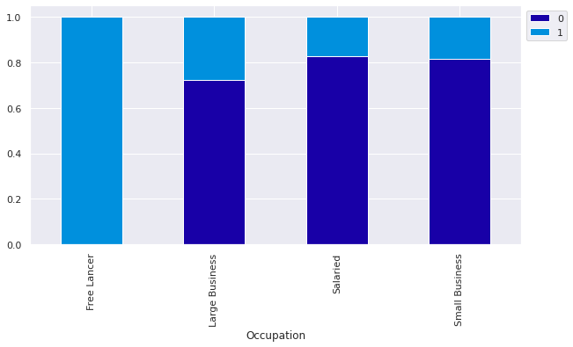
Occupation
Freelancers make up a very small number of customers but both purchased travel packages. About 28% of Large Business owners purchased packages.

Slide 17
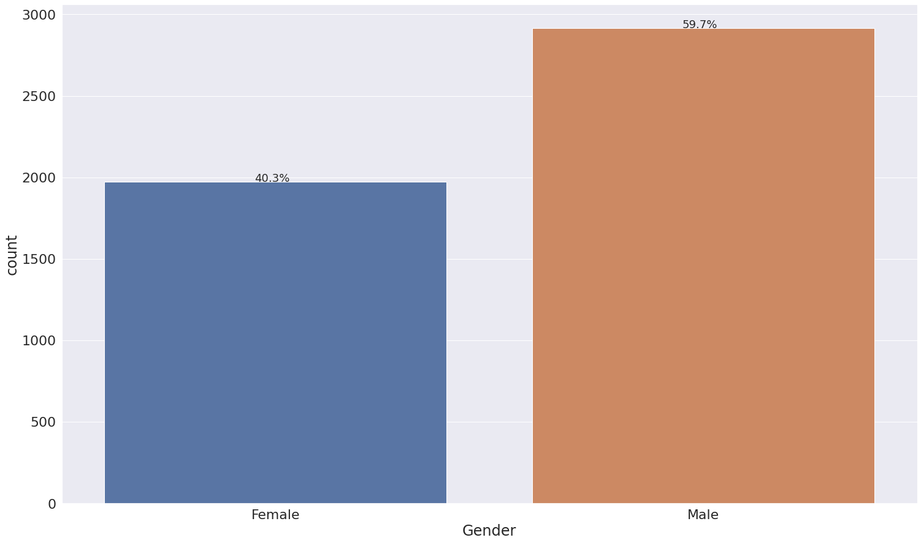
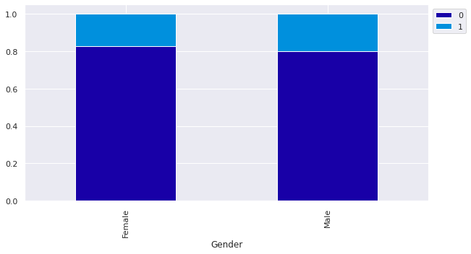
Gender
Most customers are male. By a very slight margin, the percentage of males who purchase a package is greater than females.

Slide 18
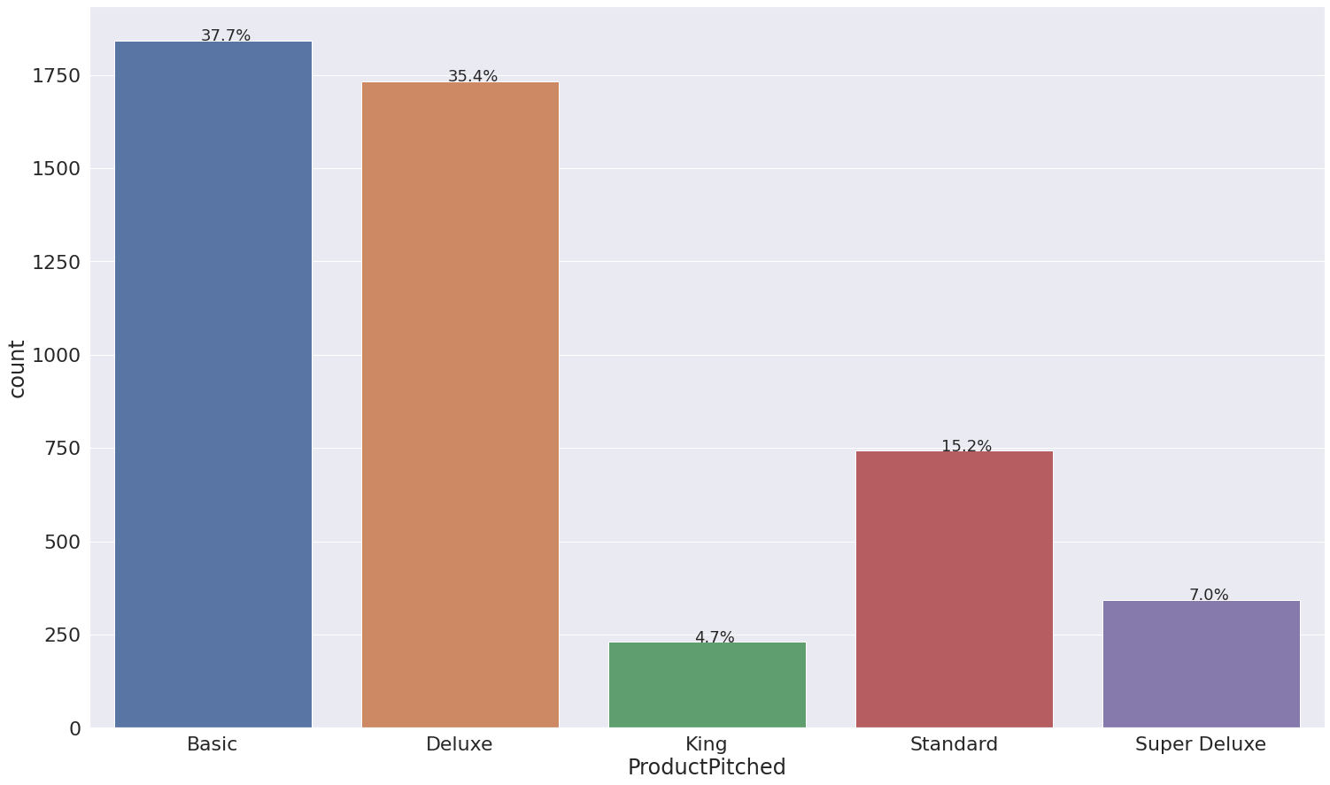
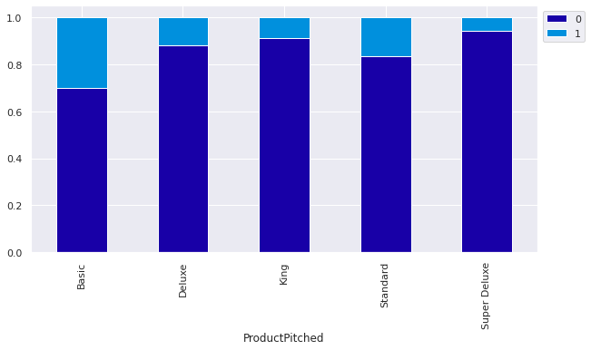
Product Pitched
Most salespeople pitched the Basic package. A higher percentage of Basic packages pitched were purchased, with Standard packages being the next in line.

Slide 19
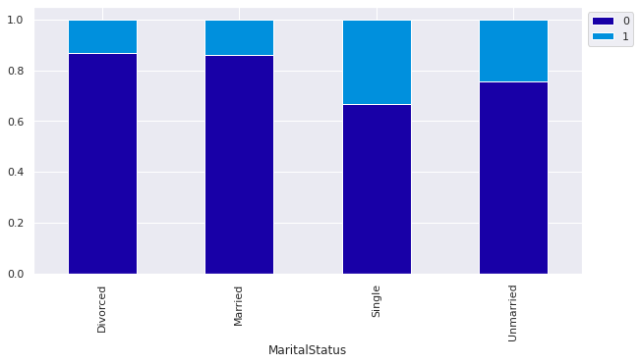
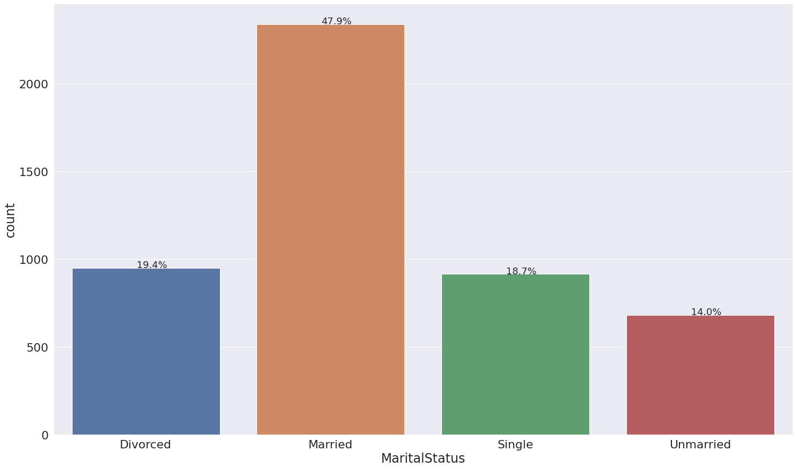
Marital Status
Most customers are married. Although a greater number of packages were sold to Married customers, within the Single category, a larger percentage of those customers decided to purchase a package.

Slide 20
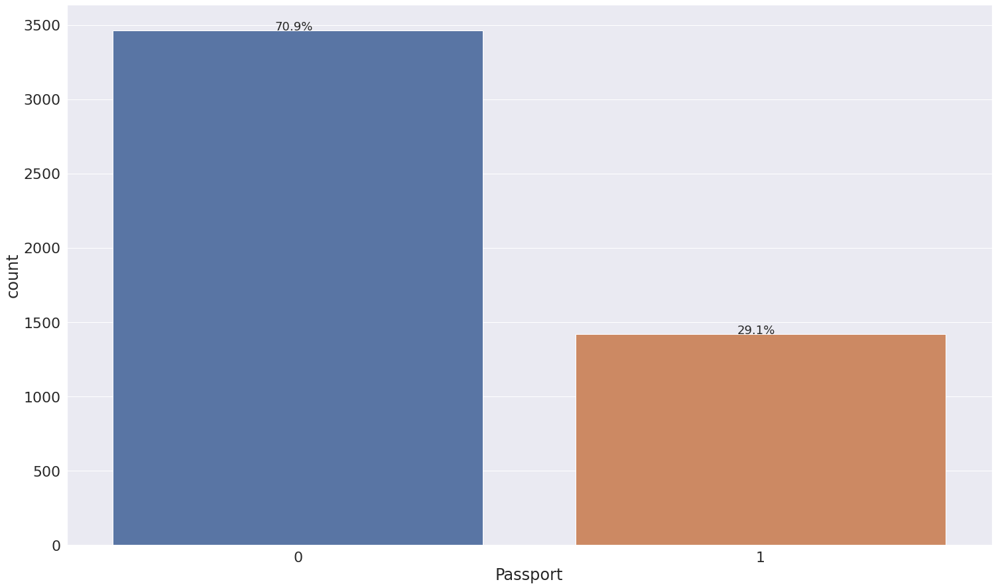
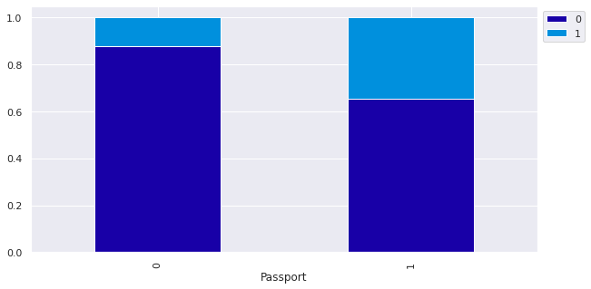
Passport
Most customers do not have a passport. A larger percentage of those customers with passports purchased packages.

Slide 21
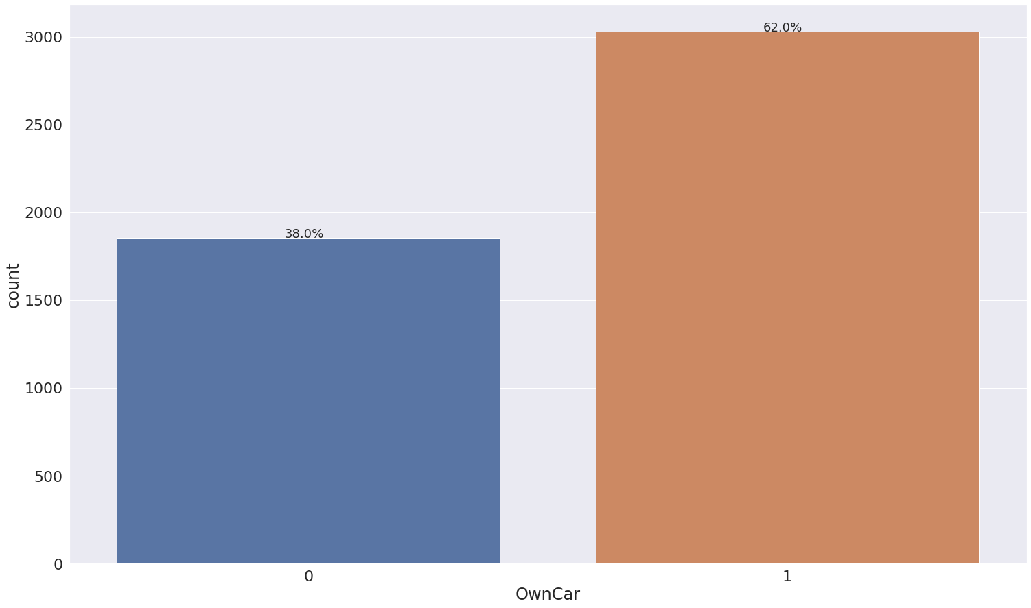
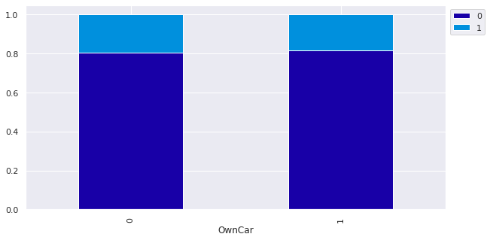
Own Car
Most customers own their own car. It seems equally likely that a customer will purchase a package whether they own a car or not.

Slide 22
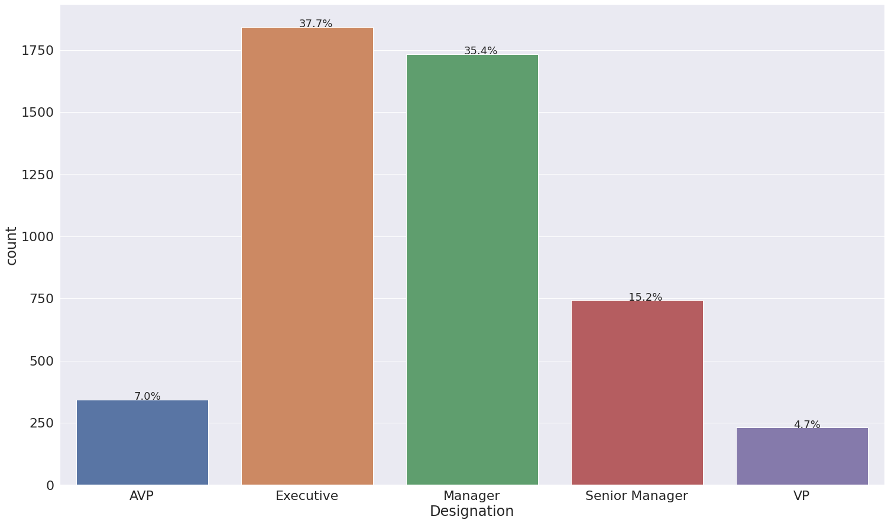
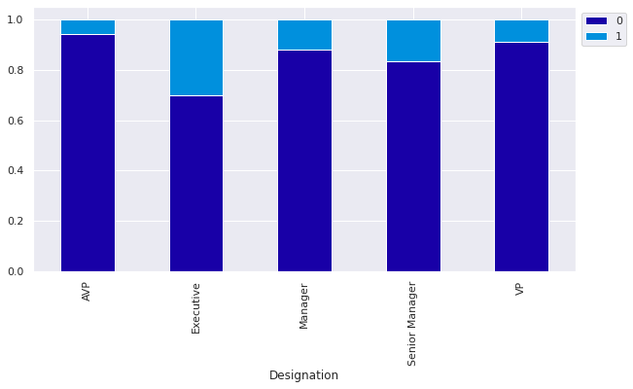
Designation
Most are designated as Executive. A larger percentage of the Executive designation purchased a package.

Slide 23
Model Summary
The tuned XGBoost model performed the best on the Test data without overfitting.

Slide 24
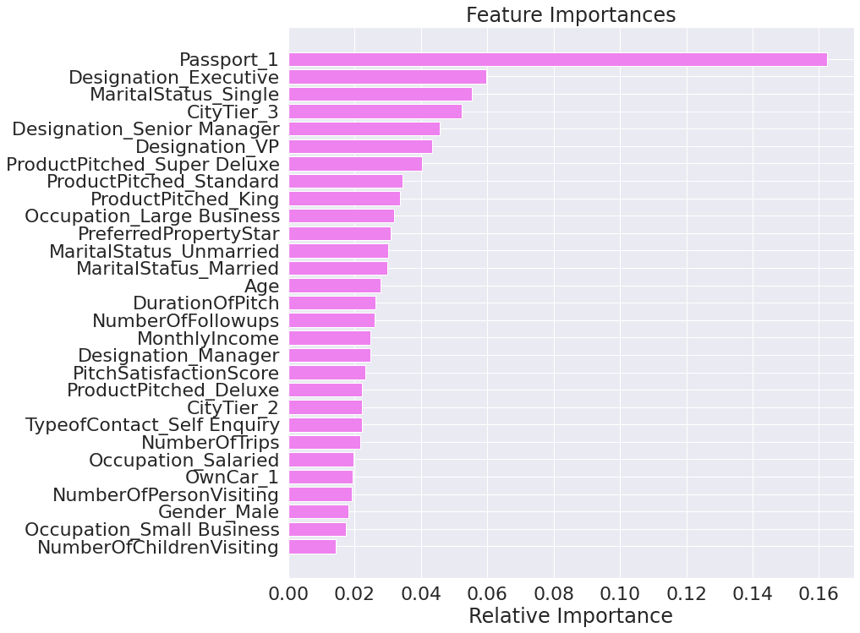
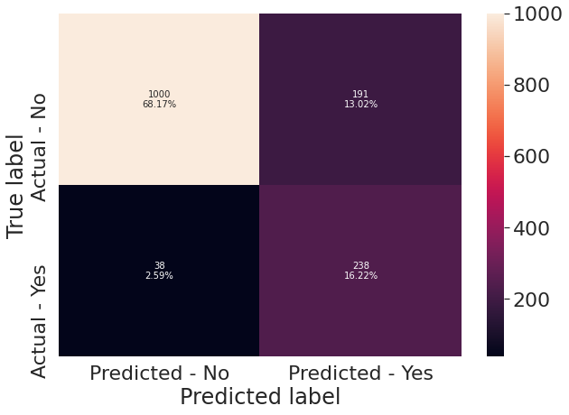
Tuned XGBOOST MODEL

Slide 25
Conclusion
Passport ranks as by far the most influential predictor. Customers with passports are more likely to purchase a package. Marketing could explore setting up programs to guide potential customers in getting their passports since the vast majority of potential customers do not have passports.
Designation is an important predictor of whether or not a customer will purchase a package. A higher percentage of Executive members purchase packages. Marketing could explore designing campaigns or packages targeting the Executive class.
MaritalStatus is an important predictor in determining if a customer will purchase a package. Most packages are sold to married couples, but the single customers had the highest percentage of packages purchased within their segment.
CityTier is an important predictor in determining whether a customer will purchase a package. The marketing team might further investigate if there are travel trends that dominate certain city tiers (e.g., if CityTier 1 is urban do those customer prefer packages that allow them to travel to more pastoral settings).
ProductPitched - The packages that seem more successfully pitched are the Basic and Standard. The Marketing team needs to further investigate if this is because of cost or some other characteristic of the package itself (destinations, availability, amenities included, etc.)
Number of children and persons visiting are not important features for prediction. Marketing need not focus on group or perhaps even family-friendly marketing strategies.
Further research should be done, perhaps in the form of a survey, to determine whether the planned package for Wellness Tourism is a highly desired package for potential customers as current data does not provide adequate insight.

